Slide 1



Part 1: Technological mediation & public values
Personalization for (public) media
Dr. Karin van Es
Assistant Professor Utrecht University
K.F.vanEs@uu.nl

Slide 2
Lecture: Thursday All together: 11:00-12:45 Lab: Tuesday Group 1: 11:15-15:00 Group 2: 15:15-19:00
Book
Schrage, Michael. 2020. Recommendation Engines. The MIT Press.
Labs
Erik Hekman (e.hekman@uu.nl) Shakila Shayan
Lecturers
Koen van Turnhout
Aletta Smit
Coordinator
Karin van Es (k.f.vanes@uu.nl)
Practical info

Slide 3
Understand and apply value-sensitive design in the design process of a recommender system
Understand and apply recommender systems in a media context
Develop metrics that are used for cluster analysis for audience analysis
Develop models for personalization and content recommendation with regards to public values
Consider ethical and cultural concerns of recommender systems
At the end of the course students will be able to

Slide 4
All assignments should be submitted via Blackboard (with the exception of the video presentation which you e-mail the link to Erik Hekman)
Please note that you need a minimum of 5.5 for the individual assignments to pass the course
Assignments & deadlines
 | Weight | Form | Deadline
Assignment 1: Value-sensitive design | 20% | individual | 25 Feb 2021, 17:00
Assignment 2: Algorithmic affordances and interfaces | 40% | individual | 25 March 2021, 17:00
Final: Case Study Building a Recommender | 40 % | group of 3 | 13 April 2021, 17:00

Slide 5
What is the relationship between technology & society?
Technological determinism (locates cause with technology) (Marshall McLuhan, Harold Innis) e.g. Arab Spring
Social construction of technology (locates cause with people) (Wiebe Bijker, John Law) e.g. moral panics
Social shaping of technology (mutual shaping)
(Donald MacKenzie, Judy Wajcman) e.g. RT button on Twitter

Slide 6
Three appoaches to human-technology relations
Extension: technology instrumental, seen as neutral
Dialectics: opposition, technology as overpowering or alienating
Hybridity: technologies and humans help to shape each other

Slide 7

Technological mediation – Peter-Paul Verbeek
Technologies <-> Humans [<-> the world]
Not two poles between which there is interaction
They are the result of their interaction

Slide 8

Technologies
Recommender systems as complex socio-technical assemblages
Values
People

Slide 9
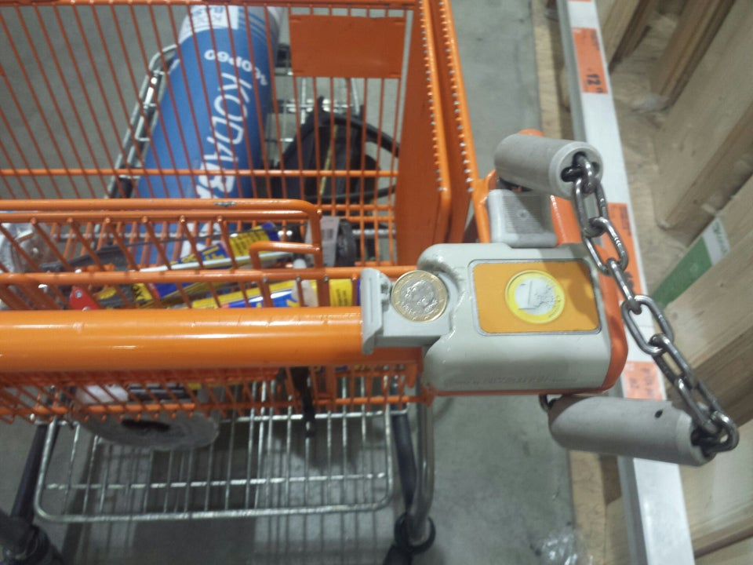


Tool Criticism
Designers materialize morality
“Technologies help shape perceptions and actions, experiences and practices” (p.29)

Slide 10
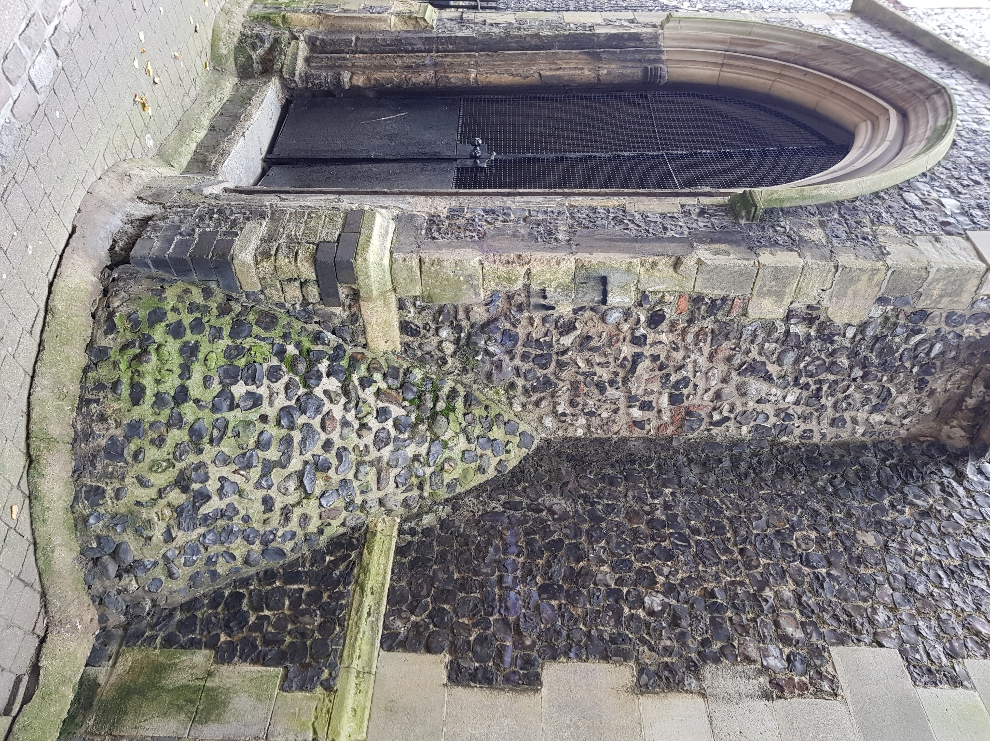
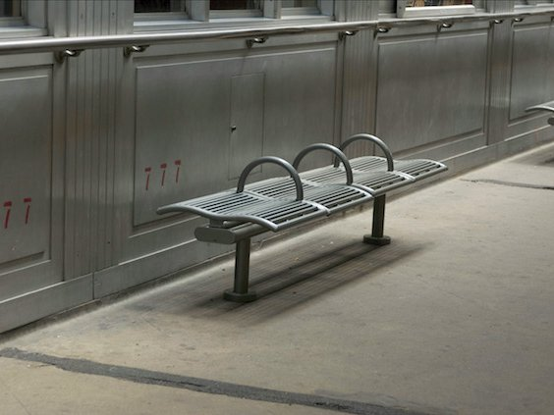

Hostile architecture (moral dimension of technology)

Slide 11
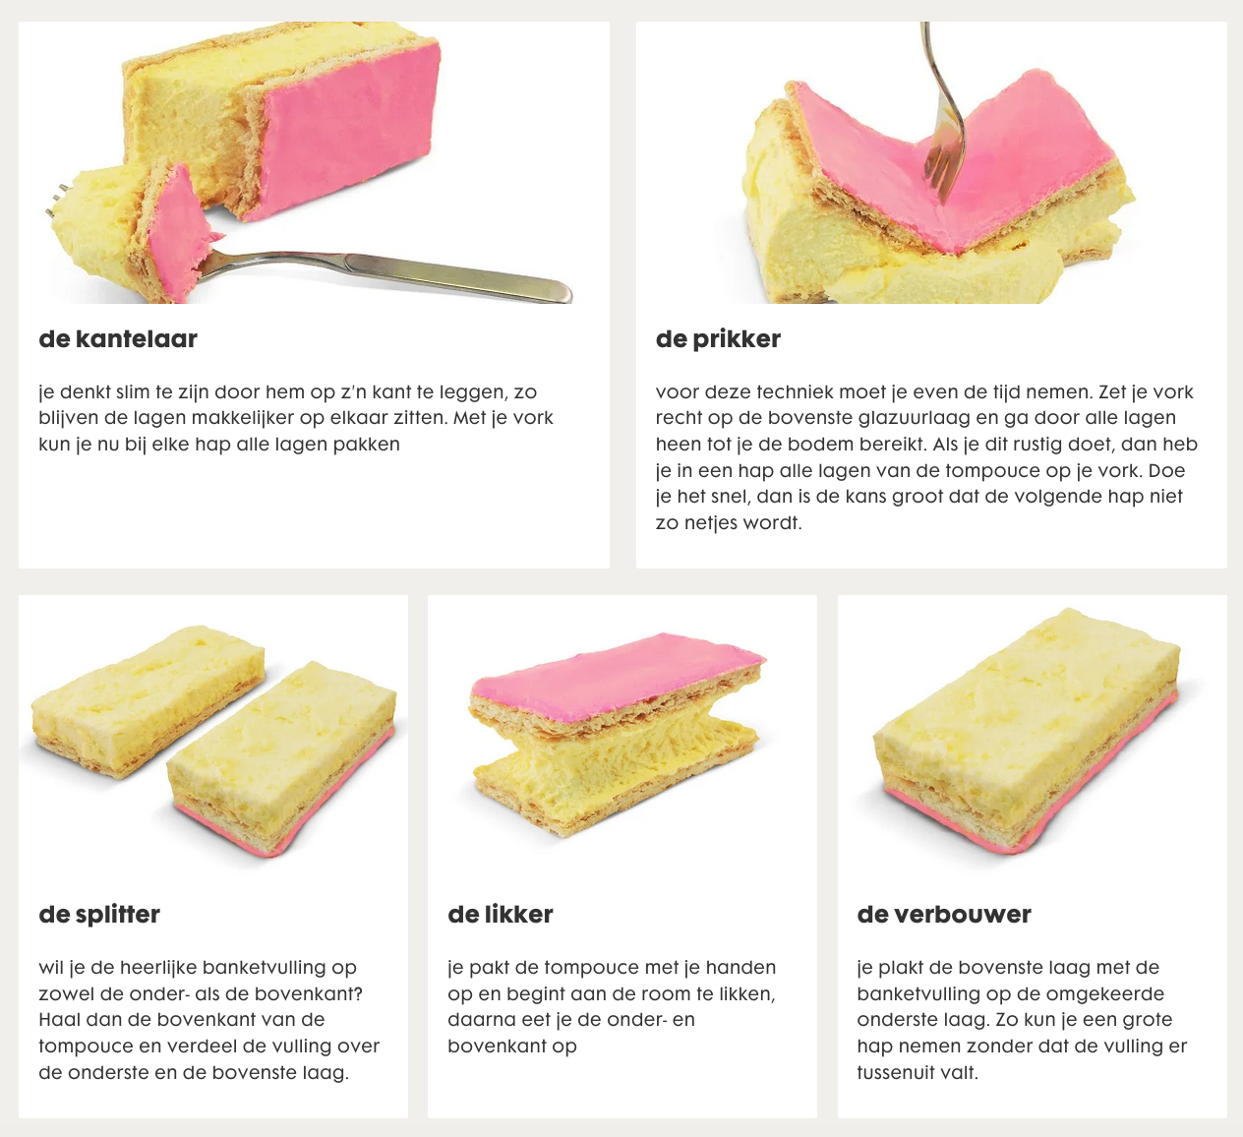
“Algorithms are created for purposes that are often far from neutral: to create value and capital; to nudge behavior and structure preferences in a certain way; and to identify, sort and classify people” (Kitchin, 2014:18)
Hema – Hoe eet je een tompouche

Slide 12
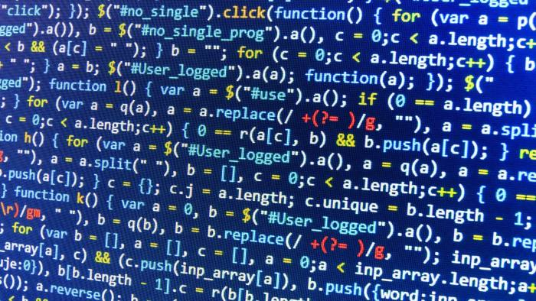
“While programmers might seek to maintain a high degree of mechanical objectivity – being distant, detached and impartial in how they work and thus acting independent of local customs, culture, knowledge and context (Porter, 1995) - in the process of translating a task or process or calculation into an algorithm they can never fully escape these.” (Kitchin, 2014:18)

Slide 13
What are media?
“Technologies that are able regularly and reliably to transmit or preserve meanings across space and time” (Couldry, 2020: 4).

Slide 14
What is ‘public’ in relation to media?
“concerning the people as a whole”
“belonging to the State rather than to an independent, commercial company”
-> soon linked to public service
-> remains difficult to exactly define, specific in national contexts
(Ibarra, 2015: 149)
Inform, Educate and Entertain

Slide 15
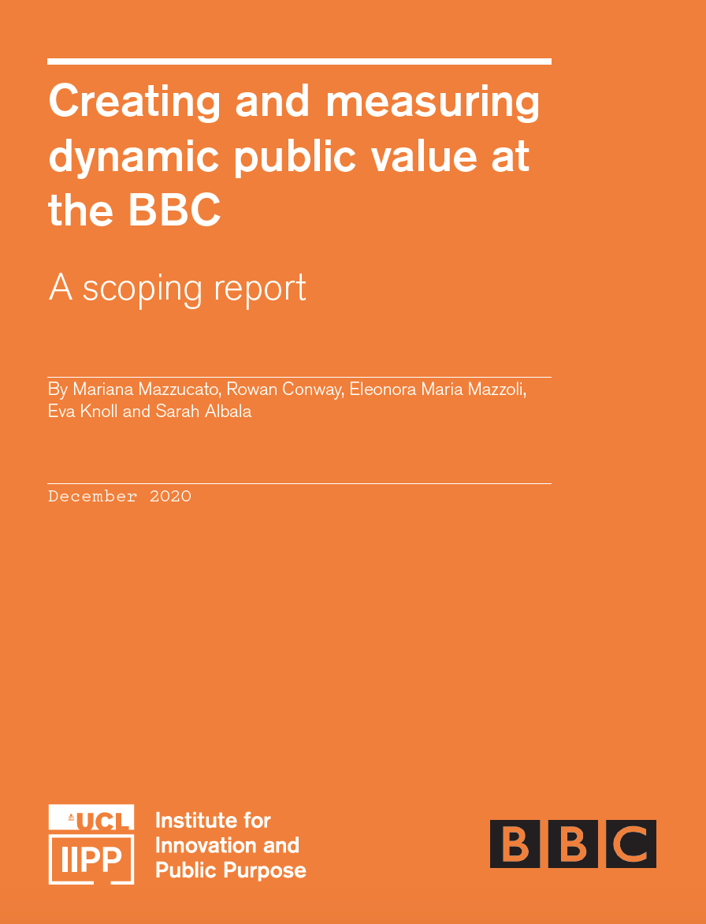
Tool Criticism
“While the field of economics and its influence on government thinking has been stuck in a market-fixing view of the state, in management literature, the term “public value” is used to describe the role of the public sector in the broader creation of value” (p. 12)

Slide 16
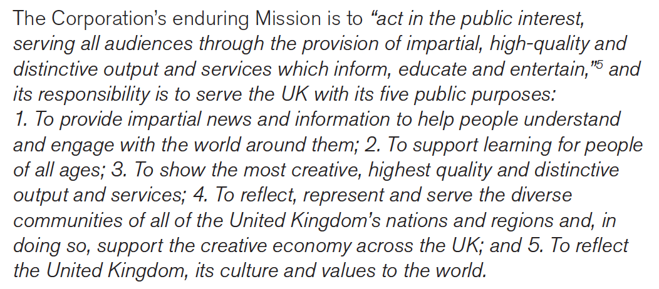
Tool Criticism
BBC brought public value to the media industry

Slide 17
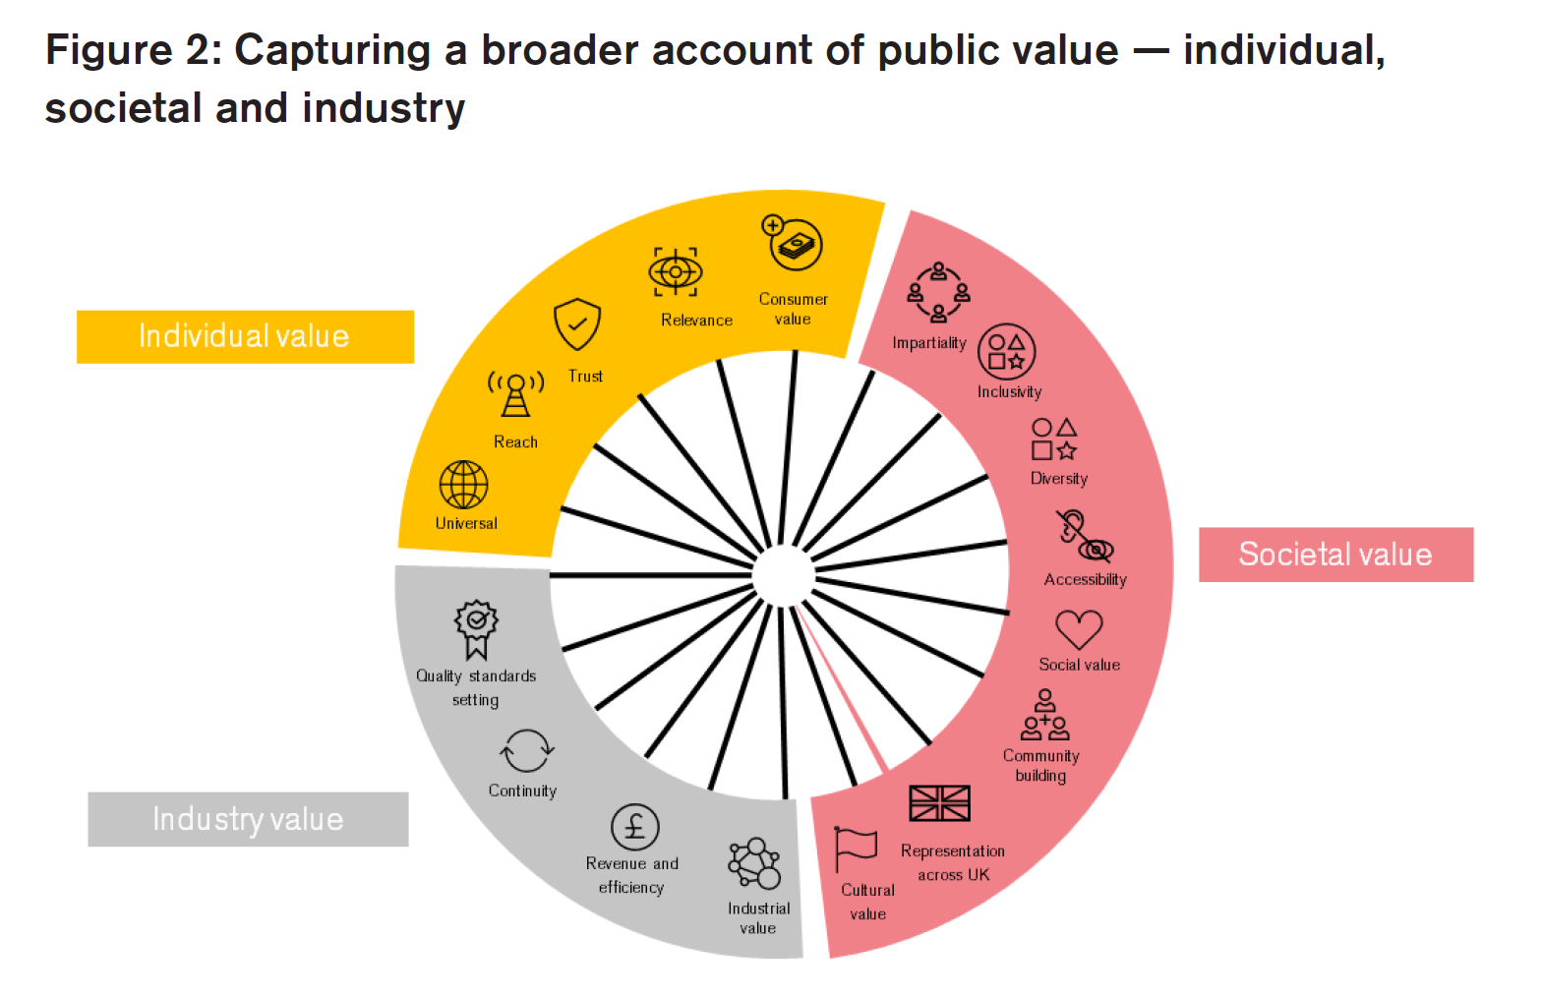
Tool Criticism
(Mazzucato et al, 2020: 24)

Slide 18













Slide 19
Tool Criticism
Colonization of the data imaginary – (William Uricchio, 2018)
Regardless of the institutional or cultural setting, data mean pretty much the same thing
Overarching conformity is professionalism

Slide 20
Tool Criticism
Impending crisis of imagination – (Karin van Es, 2017)
“they [PSM] have to make an explicit effort to think outside the commercial toolbox and consider how they can use Big Data to support their public remits”
* challenge is measuring public value

Slide 21
Readings: Mazzucato, Mariana and Rainer Kattel. “Getting Serious About Value.” Institute for Innovation and Public Purpose (June 2019). Helberger, Natali, Kari Karppinen and Lucia D’Acunto. “Exposure diversity as a design principle for recommender systems.” Information, Communication & Society 21, no. 2 (2018): 191-207. Van Dijck, José, Thomas Poell and Martijn de Waal. “Chapter 3: News.” The Platform Society, Oxford: Oxford University Press, 2019.
Invitation to seminar ‘Public Value in PSM’
Feb. 19, 11:15 AM - 12:45 PM (join via https://teams.microsoft.com/l/team/19%3a16b0d3ddd49047e7bd20f28ee66648b4%40thread.tacv2/conversations?groupId=cd7e4422-3643-496a-aa19-0b17e688a338&tenantId=d72758a0-a446-4e0f-a0aa-4bf95a4a10e7)

Slide 22
break

